Slide 1

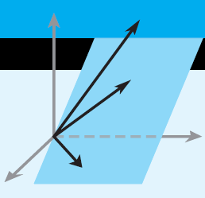
Howard Anton
Copyright © 2014 by John Wiley & Sons, Inc.
All rights reserved.
Chapter 4
Page 169

Slide 2
Chapter 4 General Vector Spaces
4.1 Real Vector Spaces
4.2 Subspaces
4.3 Linear Independence
4.4 Coordinates and Basis
4.5 Dimension
4.6 Change of Basis
4.7 Row Space, Column Space, and Null Space
4.8 Rank, Nullity, and the Fundamental Matrix Spaces
4.9 Matrix Transformations from R^{n} to R^{m}
4.10 Properties of Matrix Transformations
4.11 Geometry of Matrix Operators on R²
4.12 Dynamical Systems and Markov Chains
Page 209

Slide 3
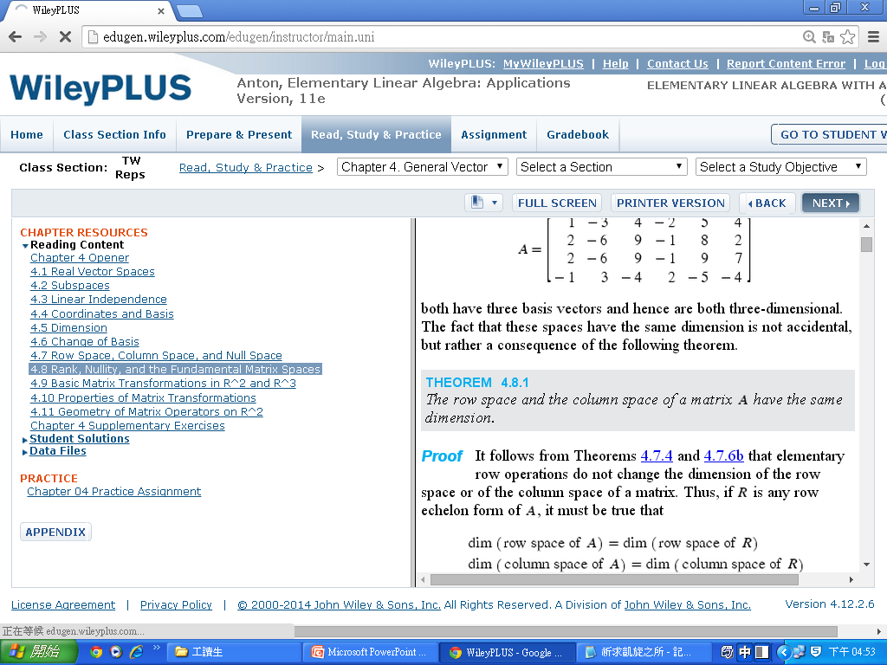
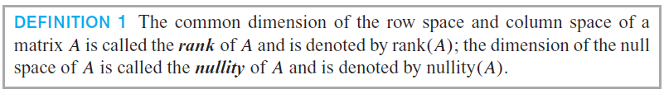
Section 4.8
Rank, Nullity, and the Fundamental Matrix Spaces

Slide 4
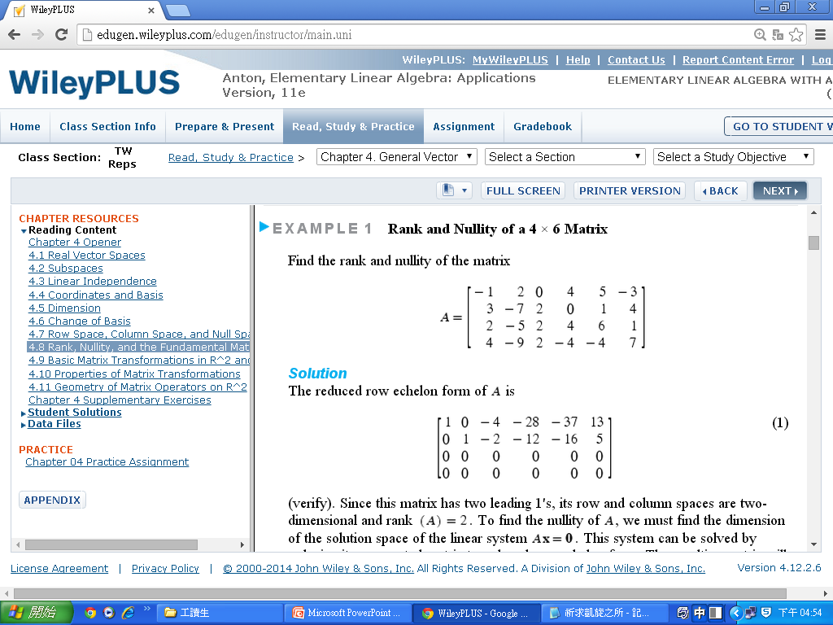
Section 4.8
Rank, Nullity, and the Fundamental Matrix Spaces

Slide 5
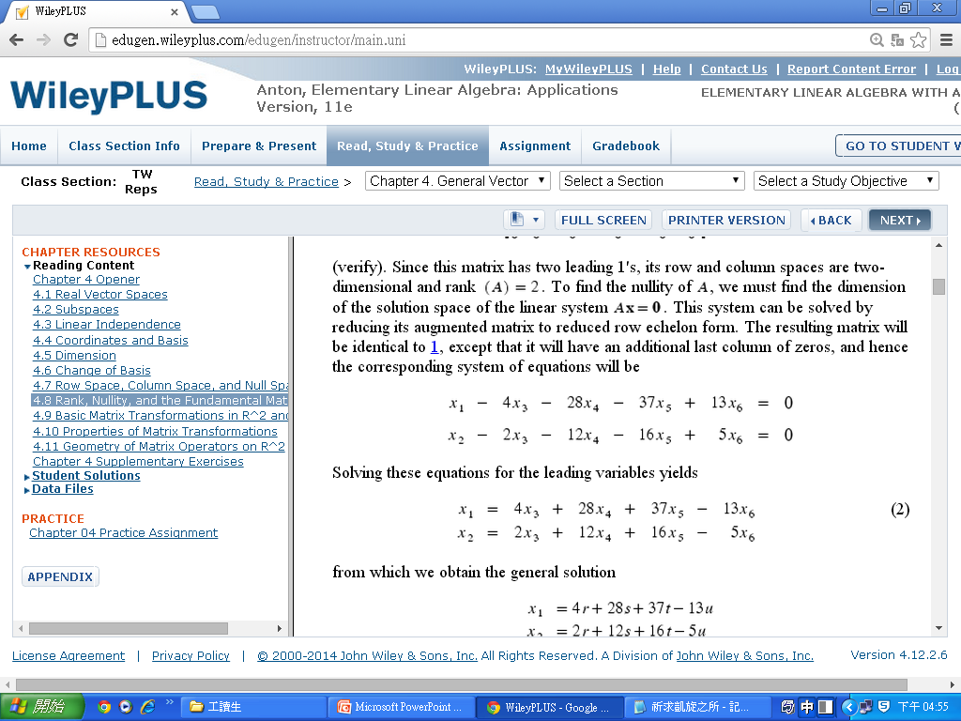
Section 4.8
Rank, Nullity, and the Fundamental Matrix Spaces

Slide 6
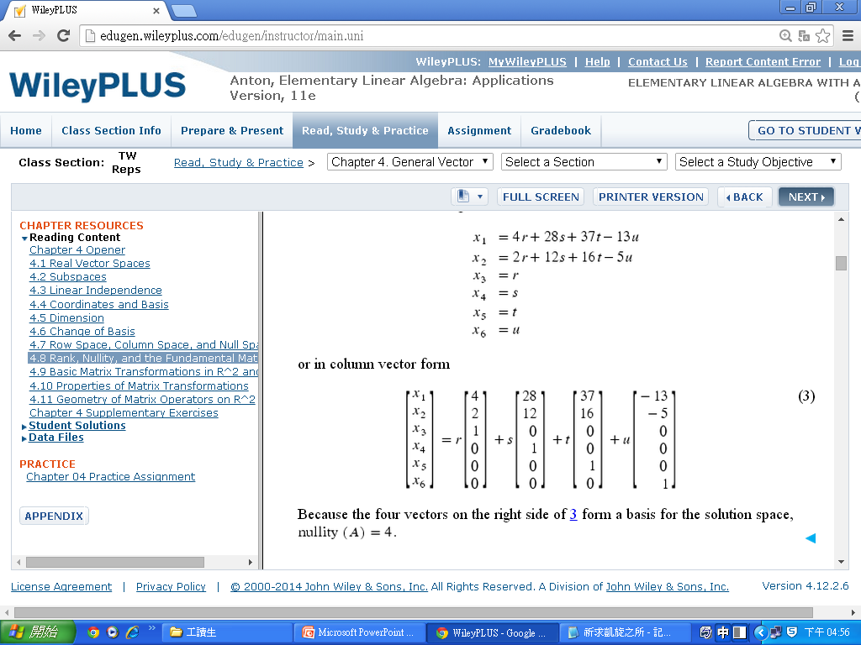
Section 4.8
Rank, Nullity, and the Fundamental Matrix Spaces

Slide 7
Section 4.8
Rank, Nullity, and the Fundamental Matrix Spaces

Slide 8
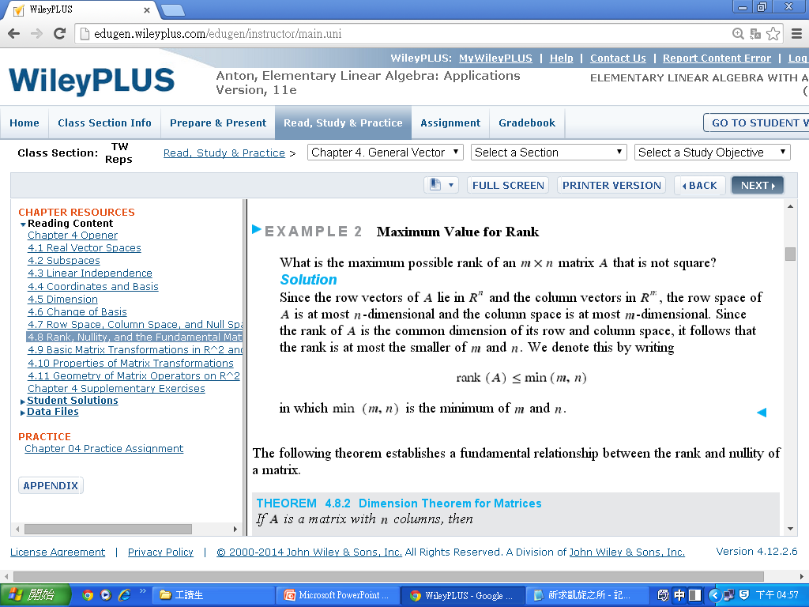
Section 4.8
Rank, Nullity, and the Fundamental Matrix Spaces

Slide 9
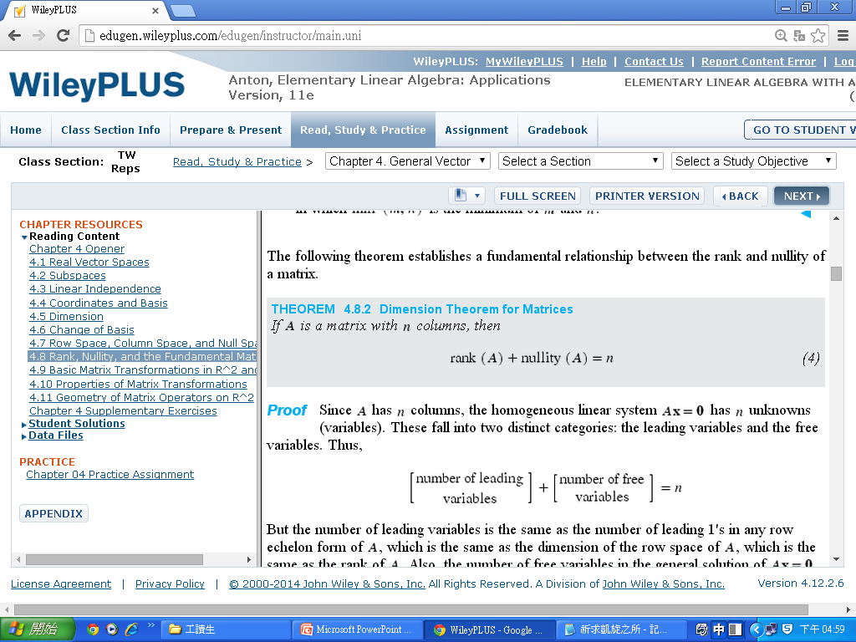
Section 4.8
Rank, Nullity, and the Fundamental Matrix Spaces

Slide 10
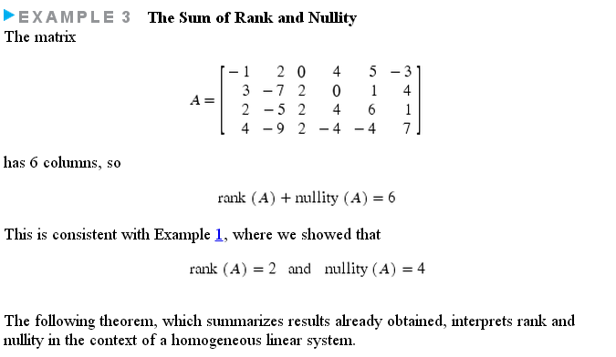
Section 4.8
Rank, Nullity, and the Fundamental Matrix Spaces

Slide 11
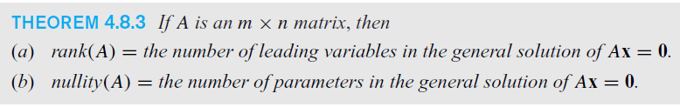
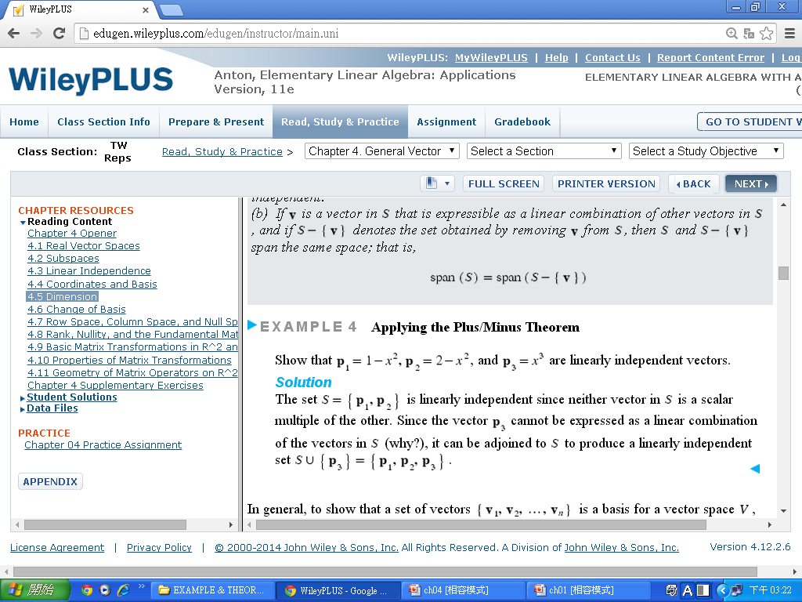
Section 4.8
Rank, Nullity, and the Fundamental Matrix Spaces
Number of Parameters in a General Solution
Find the number of parameters in the general solution of Ax = 0 if A is a 5 × 7 matrix of rank 3.
Solution
From (4),
nullity(A) = n － rank(A) = 7 – 3 = 4
Thus there are four parameters.

Slide 12
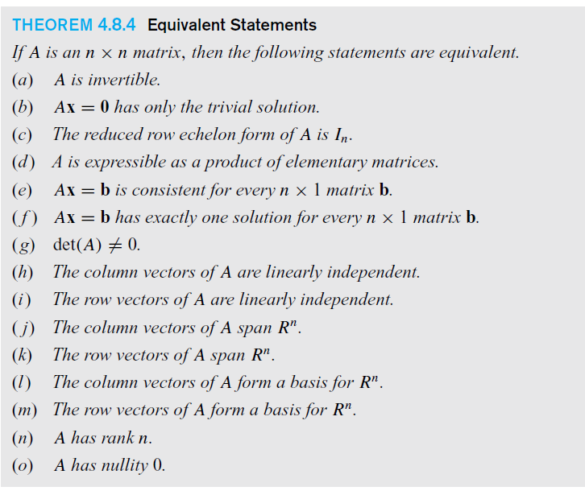

Slide 13
Section 4.8
Rank, Nullity, and the Fundamental Matrix Spaces
Page 228
THEOREM 4.8.5 If Ax = b is a consistent linear system of m equations in n un-knowns, and if A has rank r, then the general solution of the system contains n – r parameters.
Page 218
THEOREM 4.8.6 Let A be an m × n matrix.
(Overdetermined Case). If m > n, then the linear system Ax = b is inconsistent for at least one vector b in R^{n}
(Underdetermined Case). If m < n. then for each vector b in R^{m} the linear system Ax = b is either inconsistent or has infinitely many solutions.

Slide 14
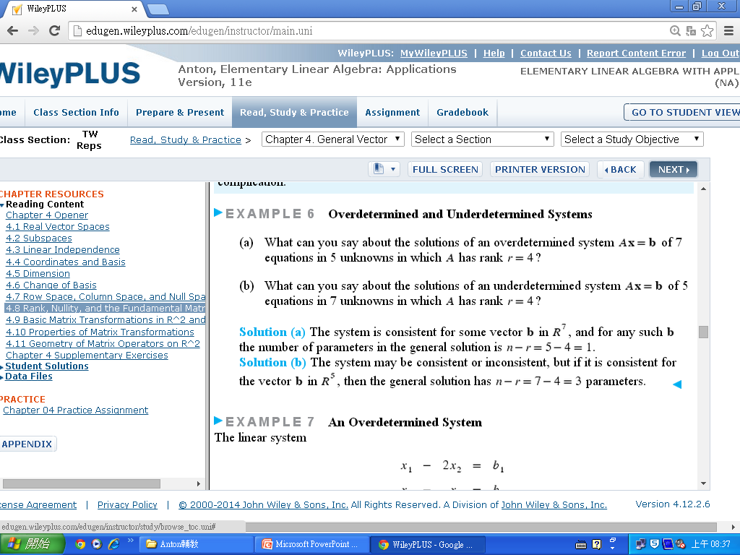
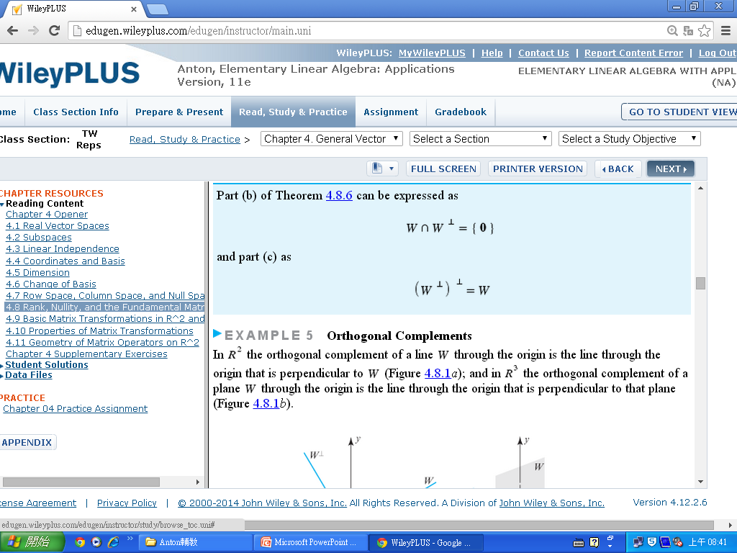
Section 4.8
Rank, Nullity, and the Fundamental Matrix Spaces

Slide 15
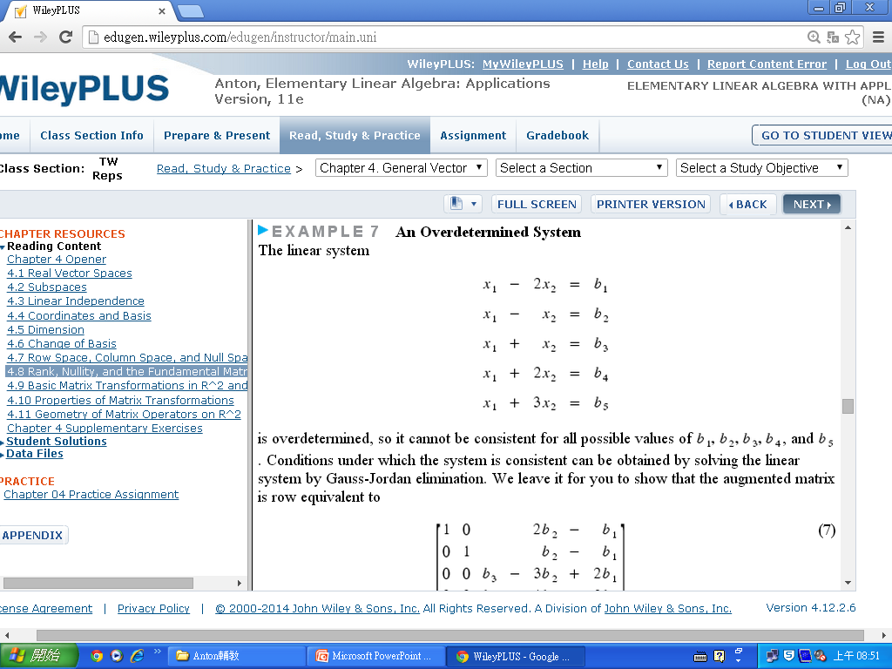
Section 4.8
Rank, Nullity, and the Fundamental Matrix Spaces

Slide 16
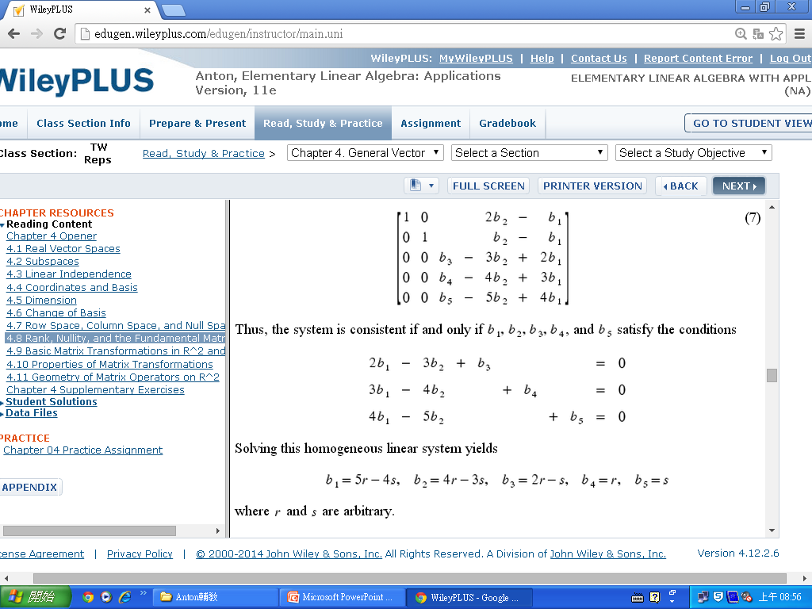
Section 4.8
Rank, Nullity, and the Fundamental Matrix Spaces
(5)

Slide 17
Section 4.8
Rank, Nullity, and the Fundamental Matrix Spaces
Page 230
THEOREM 4.8.7 If A is any matrix , then rank(A) = rank(A^{T})
Page 231

Slide 18
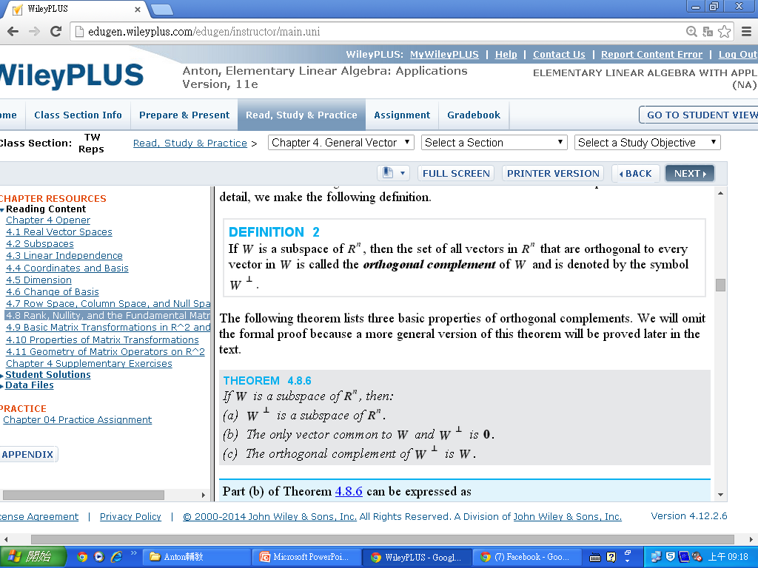
Section 4.8
Rank, Nullity, and the Fundamental Matrix Spaces
THEOREM 4.8.8 If W is a subspace of R^{n}, then:
(a) W⊥ is a subspace of R^{n}.
(b) The only vector common to W and W⊥ is 0.
(c) The orthogonal complement of W⊥ is W.

Slide 19
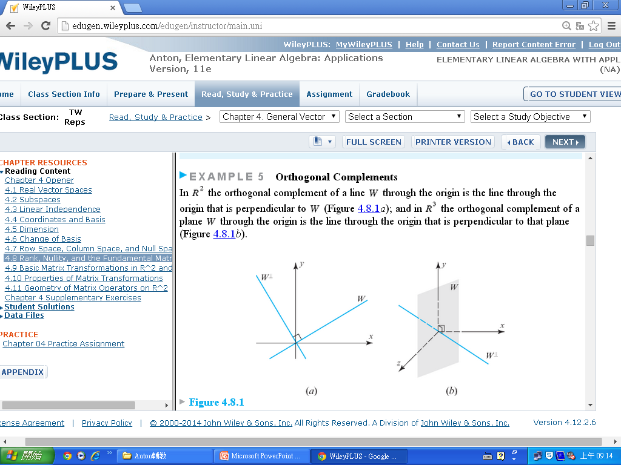
Section 4.8
Rank, Nullity, and the Fundamental Matrix Spaces

Slide 20
Section 4.8
Rank, Nullity, and the Fundamental Matrix Spaces
THEOREM 4.8.9 If A is an m × n matrix, then:
(a) The null space of A and the row space of A are orthogonal complements in R^{n}.
(b) The null space of A^{T} and the column space of A are orthogonal complements in R^{m}.

Slide 21
